Slide 1
health metrics in predicting diabetes
Notes:
Hello. I’ll be presenting on my group’s project for the module SC1015 - Introduction to Data Science and Artificial Intelligence. Our topic is on diabetes detection using health metrics.
(15 seconds)

Slide 2
TABLE OF CONTENTS
01
02
Practical motivation
Exploratory data analysis
03
04
Core Analysis
Insights
Notes:
Here is a brief overview of the topics that we wish to cover.
(4 seconds)

Slide 3
01
Practical Motivation
Notes:
We will be starting off with our practical motivation for selecting this topic.
(5 seconds)

Slide 4
422 million
Individuals has diabetes worldwide according to the World Health Organisation (2022).

Slide 5
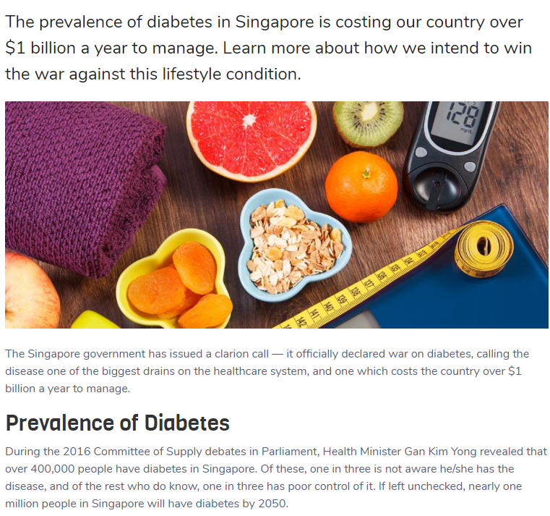
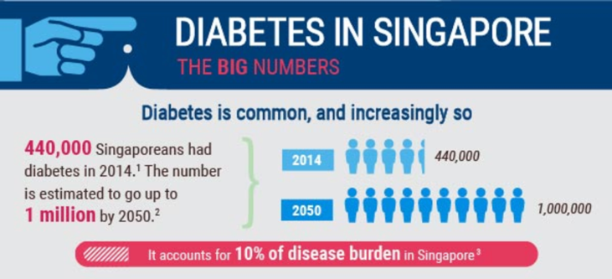
Fig. 2: Diabetes in Singapore.
(James, T., n.d.)
Fig. 1: Prevalence of Diabetes in Singapore.
(Singapore’s War on Diabetes, 2021)
Notes:
Type 2 diabetes, or lifestyle diabetes, is a form of diabetes that one can acquire as one gets older. Diabetes is surprisingly common in Singapore. An estimate in 2014 put the number of Singaporeans with diabetes at 440 thousand, which comprises about 10% of the population at the time. This number is projected to grow to 1 million by 2050. To put that into perspective, the population is predicted to settle around 6.4 million individuals by 2050. That would mean that about 1 in 6 people would have diabetes, which is a whopping 17% the Singaporean population!
To deal with this growing prevalence of diabetes, Singapore declared a “War on Diabetes” and spent a large amount of public funds on healthcare campaigns to educate the population about the risks of diabetes.
(1 minute)

Slide 6
What are some of the important health metrics in determining risk of diabetes?
Notes:
That brings us to the problem we wish to solve - what health metrics are important in predicting the risk of diabetes? To solve this, we have to evaluate an individual’s health metrics and determine whether or not they are diabetic using machine learning tools.
(7 seconds)

Slide 7
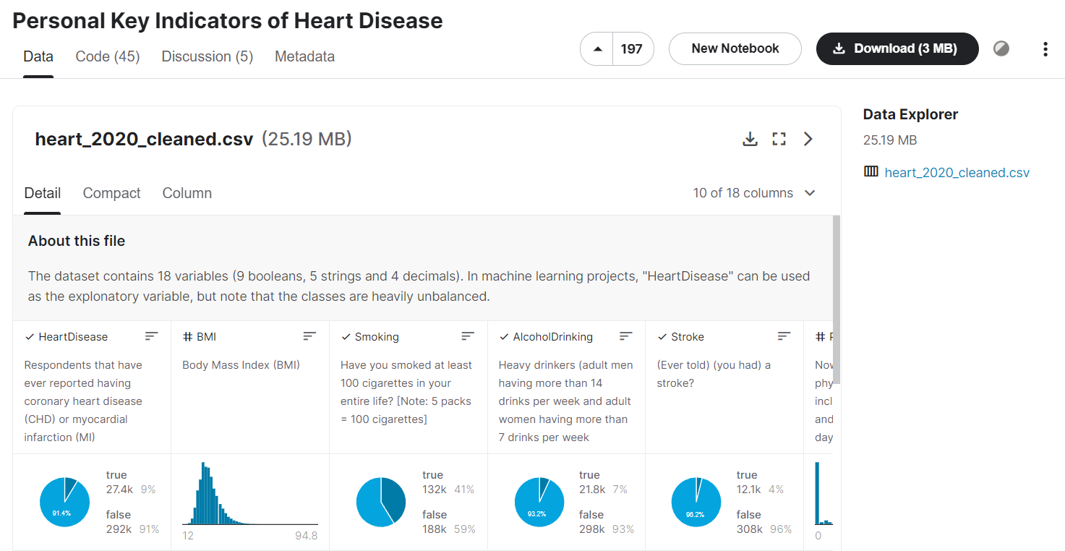

THE DATASET
Fig. 3: Personal key indicators of heart disease dataset on Kaggle (Pytlak, K., 2022)

Slide 8
02
Exploratory
Data Analysis
Notes:
I’ll move on to the exploratory data analysis (or EDA).

Slide 9
Initial Cleaning of data
Dropping duplicate entries
Dropping subjective variables:
Mental health and physical health
No missing values
Dropping diabetic variable categories:
No (with borderline diabetes) and Yes (during pregnancy) rows
Notes:
We started our exploratory data analysis with data cleaning.
As our dataset is moderately imbalanced, we decided to drop all duplicate entries in the dataset to make it more balanced. However, in doing so, we acknowledge that we might be removing unique entries which can distort the distribution of data.
We also decided to drop 2 variables, physical health and mental health. We felt that the questions were poorly framed to obtain the data and made responses highly subjective.
A quick check for null values yield no null entries.
And, we decided to drop all entries for borderline diabetes and gestational diabetes, as they were ultimately not meaningful to our investigation.
(1 minute)

Slide 10
VARIABLES AT A GLANCE
BMI | Sleep Time | Sex
Age Category | General Health | Race
Physical Activity | Alcohol Drinking | Smoking
Difficulty Walking | Asthma | Kidney Disease
Skin Cancer | Heart Disease | Stroke
Legend:
Numeric Categorical
Notes:
The 15 remaining variables were categorised into numeric and categorical variables as shown.

Slide 11
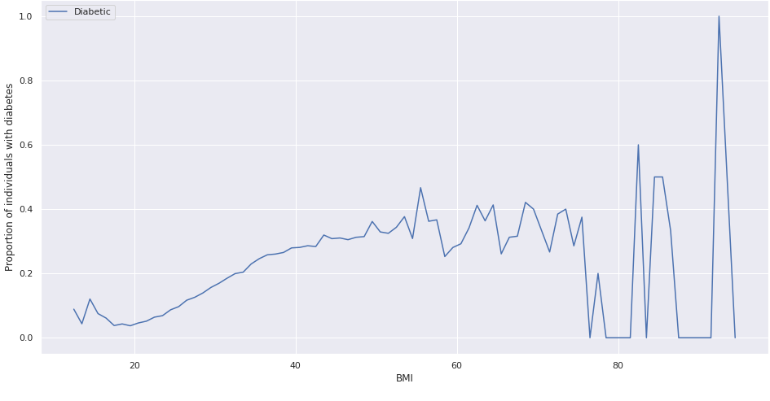
BMI & Diabetes
Fig. 4: Proportion of diabetic individuals against BMI
Notes:
Next, we moved onto analysing numeric values. We can see that in this graph the proportion of individuals with diabetes beyond a BMI of 75 is quite erratic as the sample size is very small. Due to this, we will only consider the data points up to BMI == 75.
We identified two trends in the data:
from BMI == 12 to BMI == 50, there seems to be a increase in the proportion of individuals with diabetes, and
from BMI == 50 to BMI == 75, the proportion seems to be relatively constant with some level of fluctuation.
These trends seem to indicate that BMI has a relation with diabetes.
Moreover, considering the shape of the curve - it resembles a logistic regression curve - there might be a possible linear relation between BMI and the logit of odds of having diabetes, suggesting that BMI is a good variable to use to predict diabetes.
(1 m 15 s)

Slide 12
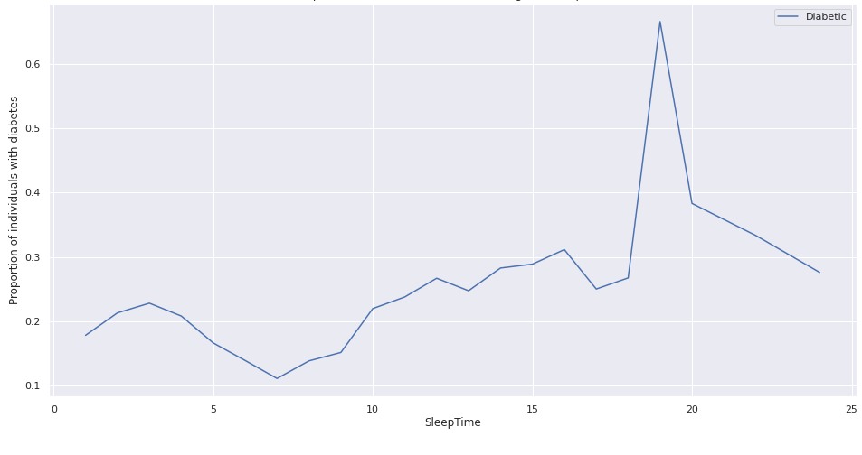
sleep time & Diabetes
Fig. 5: Proportion of diabetic individuals against sleep time
Notes:
Similarly, for SleepTime equals 19, 21, and 23, the sample size is very small so these data points may distort the trend.
There are 2 trends in the data.
The proportion decreases from SleepTime == 1 to SleepTime == 7, and
The proportion increases from SleepTime == 7 to SleepTime == 24.
This highlights the possibility that SleepTime and the logit of odds of having diabetes have a relationship but it may not be linear.
To test this theory, we trained 2 logistic regression models using sleep time as the only predictor. When SleepTime was changed from a linear feature to a polynomial feature, the model turned out better as it no longer always predicts "No".
(1 min 5 s)

Slide 13
Modifications to dataset
Polynomial Feature was used to model sleep time.
Dropping outliers based on box plots.
The data was transformed into a Gaussian distribution of mean = 0 and s.d. = 1.
Notes:
As such, we decided to apply a PolynomialFeature transform to SleepTime in our models.
Some other modifications we made to the data are:
We dropped all outliers based on a boxplot.
We scaled numeric data down such that it has a mean of 0 and a standard deviation of 1.

Slide 14
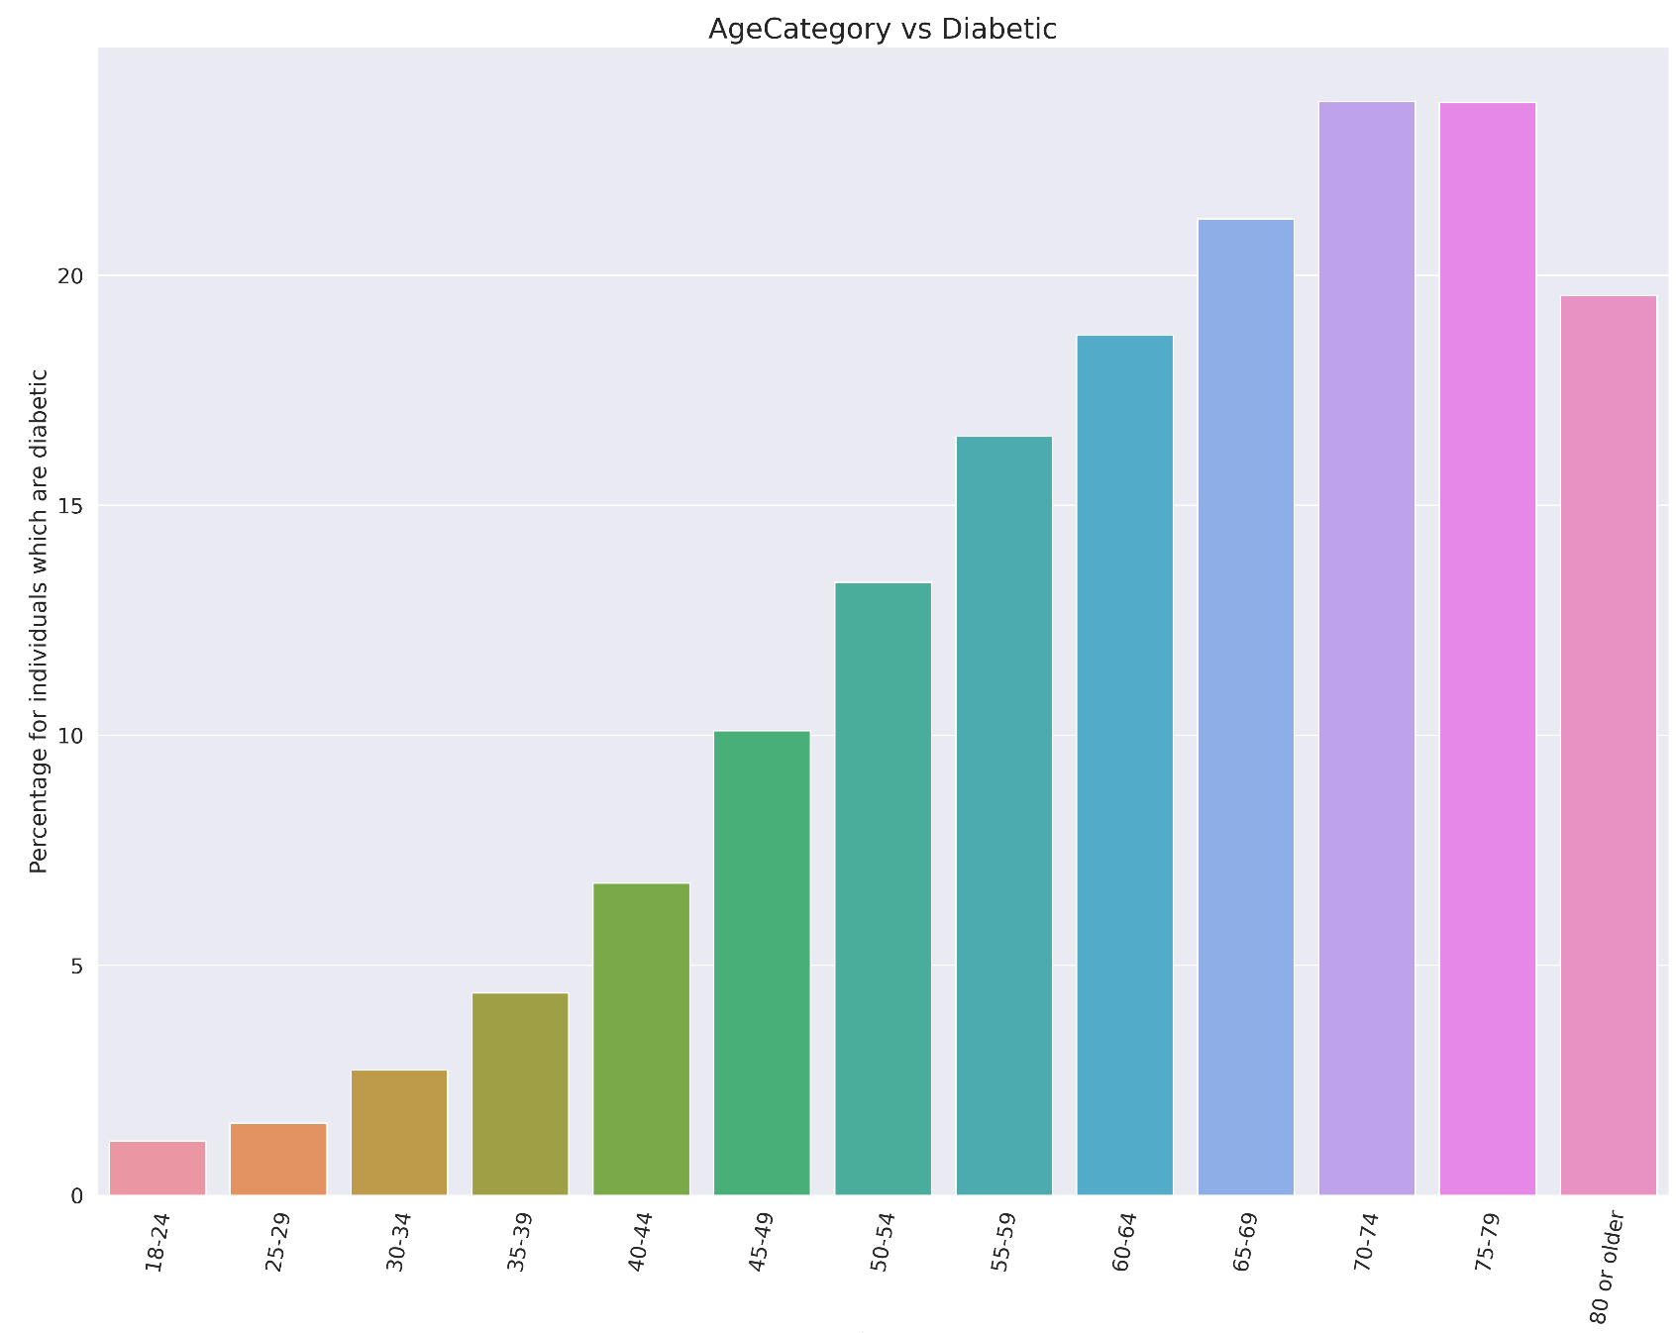
Age Category & diabetes
Fig. 6: Percentage of diabetic individuals with age category
Notes:
Out of the 13 categorical variables, we will discuss how we analysed one of them. We used bar plots to visualize the proportion of respondents who were diabetic according to each categorical variable. For example, this bar plot depicts the proportion of respondents who were diabetic arranged in ascending order according to age and suggests that the higher the age, the greater the proportion of diabetic individuals.

Slide 15
Initial insights
Categorical variable | Relationship with Diabetes (response variable)
Age Category | Proportion increases with age
Others | Proportion changes significantly
Sex, Asthma, Skin Cancer | Proportion remains relatively similar
Most categorical variables show a relationship with diabetes.
Notes:
These upward trends suggests a relationship between age category and diabetes. We applied a similar line of thinking to all of the remaining categorical variables, and discovered that all remaining categorical variables have a general relationship with diabetes.
(1 m 30 s)

Slide 16
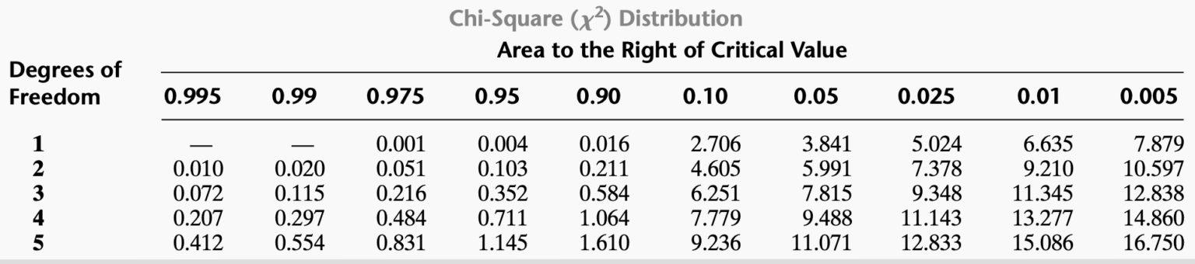
CHi-squared Test of independence
Null hypothesis
Alternative hypothesis
Independence
Association
Fig. 7: Chi-square distribution table (Seb, 2021)
Existence of Relationship
Strength
Chi-squared value (χ2) ≥ critical value
χ2 → Cramer’s V
Notes:
To further support such relationships, we decided to use a chi-squared test of independence.
The independence of categorical variables is denoted by the null hypothesis while the existence of association is denoted by the alternative hypothesis. The crucial parameters are as follows:
Degrees of freedom = (number of unique categories in a categorical variable - 1) * (number of unique categories in Diabetic variable - 1)
Significance level is the probability of rejecting the null hypothesis when it is in fact true.
Critical value is obtained from the chi-squared distribution table based on the two parameters.
Chi-squared test statistic is determined from the observed values and the expected frequencies for each unique category. If chi-squared test statistic is greater than or equal to the critical value, the null hypothesis is rejected, indicating association between two categorical variables.

Slide 17
CHI-SQUAREd TEST results
Categorical variable | General Health | Age Category
Chi-squared value | 23453.4700 | 15657.2020
Critical value | 9.488 | 21.026
Critical value ≥ chi-squared value? | Yes → Relationship exists | Yes → Relationship exists
Cramer’s V | 0.2832 | 0.2314
General Health and Age Category show the strongest relationship with diabetes.
Notes:
Here, the chi-squared test for age category and general health shows the existence of relationship with diabetes. The relationship holds when this test is extended to other categorical variables. In summary, both types of analysis show all categorical variables have a relationship with diabetes.

Slide 18
03
Core Analyses used
Notes:
We will move on to core analyses used.

Slide 19





Variables Used
Sleep Time
BMI
GenERAL Health
Age Category
Body mass index. A typical measurement for an individual’s physical metrics.
The approximate amount of sleep the respondents had.
Respondents’ ages in discrete categories.
Respondents were asked to rate their own personal health over the past 30 days.
Notes:
After evaluating the strength of the relationship between each variable and diabetes, we decided to use the two numeric variables - sleep time and BMI, and the top two categorical variables - general health and age category.

Slide 20
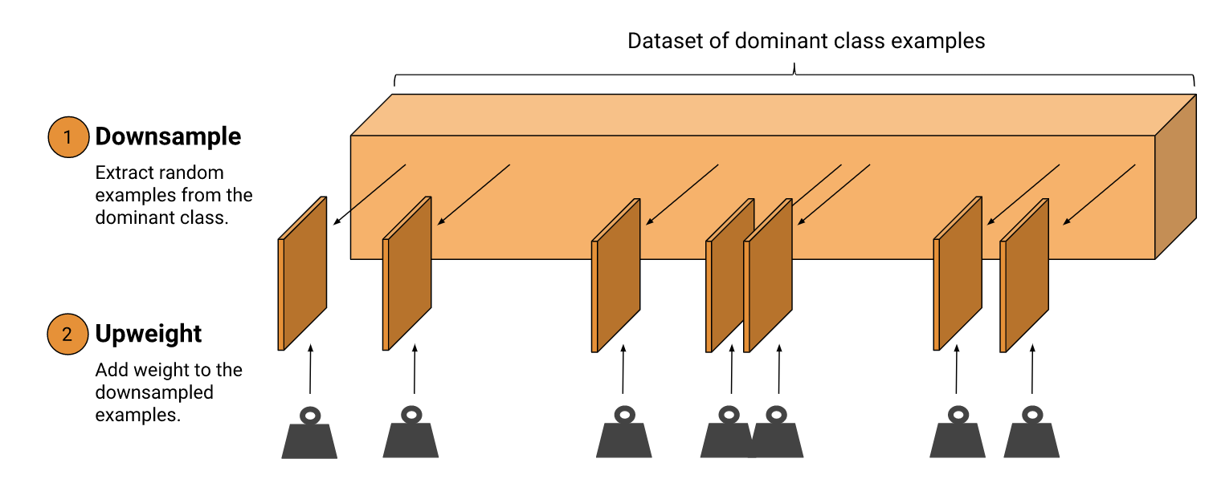
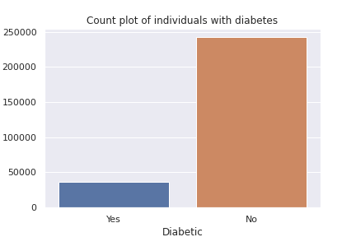
Handling Data imbalance
Our data was moderately unbalanced.
Downsampling & Upweighting
Downsampling - Undersampling
Upweighting - Relative class weight
We decided to downsample and upweight it by a factor of 6.6.
Fig. 9:
Count plot of diabetic individuals
Fig. 8: Downsample and upweight (Imbalanced Data, 2021)
Notes:
As mentioned at the start of our analysis, our dataset is moderately imbalanced. As such, we employed downsampling and upweighting to handle the class imbalance. This process involved 2 new tools: undersampling and class weights.
It should be noted that the test dataset was a random sample of entries from the cleaned dataset.
The number of respondents who do not have diabetes was approximately 6 and a half times that of those who had diabetes. To counter this, we downsampled the dominant class, and upweighted the downsampled class.

Slide 21
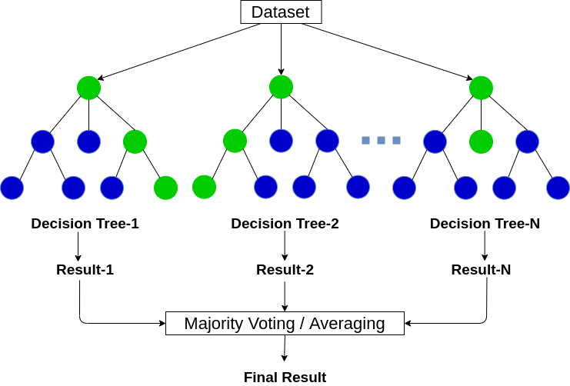
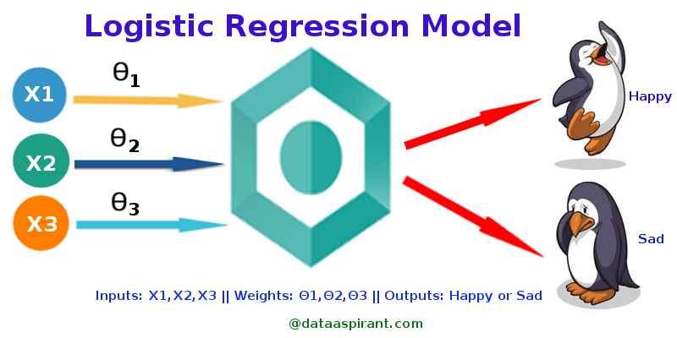
Machine Learning tools
Logistic Regression
Random Forest Classifier
Fig. 10: Logistic Regression Model (Polamuri, S., 2017)
Fig. 11: Random Forest Classifier (Sharma, A., 2020)
Notes:
Logistic Regression - Produces a discrete probability based on input variables.
Random forest classifier - Contains multiple decision trees on a subset of the whole dataset, producing a probability.
We employed 2 different models to solve the classification problem, logistic regression and random forest classifier.
(Why the models were selected?)
We decided to utilise these 2 models as they take different approaches in trying to predict the response variable. Logistic regression is a form of parametric machine learning algorithm while random forest classifier is a non-parametric machine learning algorithm.
(How the machine learning problem solves our problem?)
We intend to use both models to extract the importance of the different health metrics. From this, we will be able to know which risk factors are
We have tried our best to meet the assumptions for logistic regression, which are:
The observations are independent of each other,
There is to be little or no multicollinearity among the independent variables, and
The linearity of independent variables and log odds.
We dropped all forms of duplicated data in our data cleaning phase so there is no repeated measurements or matched data within our dataset so the first assumption is met.
However for the remaining assumptions, we have assumed them to be true.
As for the random forest classifier, no assumptions were needed as random forest classifier makes no assumptions.
More information found at: https://machinelearningmastery.com/parametric-and-nonparametric-machine-learning-algorithms/

Slide 22
04
Our
Insights
Notes:
Lastly, I would like to share with you the insights from our investigations.

Slide 23
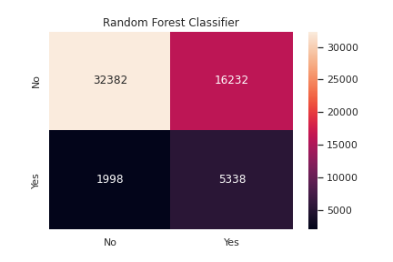

Performance of each model
Fig. 12: Confusion metrics for random forest classifier and logistic regression models
Notes:
Here are the confusion metrics for the two models compared side by side.

Slide 24
Performance of each model
Model Metrics
Accuracy | 0.699553 | 0.674173
FPR | 0.3117 | 0.333896
FNR | 0.225872 | 0.272356
AUC | 0.802888 | 0.761871
Notes:
The performances of each model can be seen in terms of the accuracy, false positive rate, false negative rate and area under the roc curve. We can see that the logistic regression outperforms the random forest classifier in terms of accuracy and has a greater AUC. It also has a lower false positive and false negative rate. Overall, we can conclude it is the more accurate model.

Slide 25
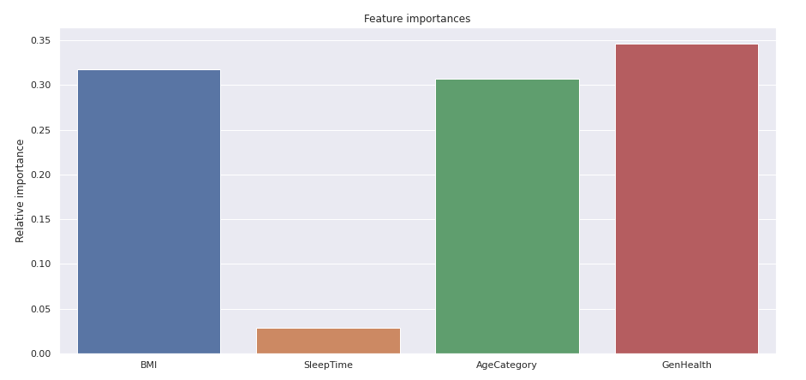
Relative feature importances for Logistic Regression
Fig. 13: Feature importances proportion in logistic regression model
Notes:
We can see here the relative feature importance for logistic regression. We can see that BMI, Age category and general health are approximately the same in terms of importance as predictors for diabetes, whereas Sleep Time is notably the least important.

Slide 26
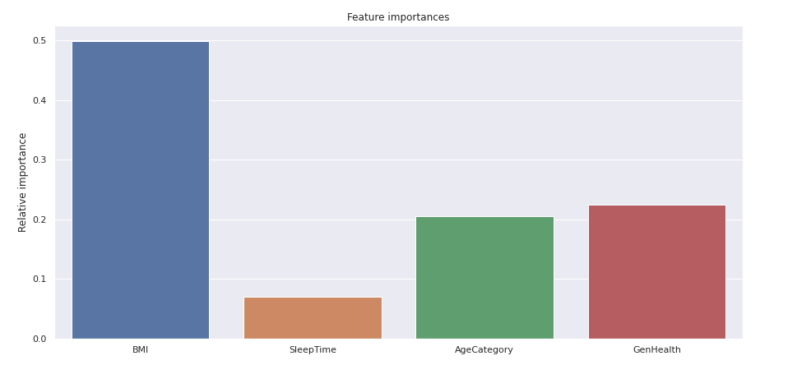
Relative feature importances For Random Forest Classifier
Fig. 14: Feature importances proportion in random forest classifier model
Notes:
And this is the relative feature importance for random forest classifier. We can see that BMI is the most important predictor, general health and age category are about half as important, and sleep time is a quarter that of BMI.

Slide 27
Conclusions
Logistic Regression > Random Forest ClassifIer
importance of variables: SIMILARITIES
Logistic Regression was more accurate (70%) as compared to Random Forest Classifier (67%).
Both models considered sleep time an unimportant factor.
Notes:
We made some conclusions from our observations. We determined that the logistical regression model is more accurate than random forest classifier. Not only that, we saw that logistic regression placed importance of the the variables more evenly, as compared to Random Forest Classifier, with a notable exception being Sleep Time. One similarity between the two models is that both models suggested that Sleep Time is a relatively unimportant feature to predicting whether one has diabetes.

Slide 28
Conclusions
importance of variables: DIFFERENCES
The two models also placed a different level of importance on each of the variables.
NUMERIC VARIABLES > CATEGORICAL VARIABLES

Slide 29

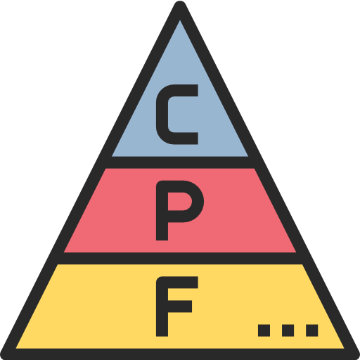

PREVENTION BETTER THAN CURE
Physical activity
Healthy diet
Portion sizes
Regular aerobic and resistance exercises.
Less sweet fruits and starchy foods. More grains and legumes.
Smaller portions reduce calorie intake and regulate insulin fluctuations.

Slide 30
Thanks!

Slide 31
References
Slide 4:
Diabetes. (2022). World Health Organization.
https://www.who.int/health-topics/diabetes#tab=tab_1
Slide 5:
James, T. (n.d.). Diabetes in Singapore. https://acetutors.com.sg/diabetes-in-singapore
Ministry of Health, Singapore (2011, Oct). National Health Survey 2010.
https://www.moh.gov.sg/docs/librariesprovider5/resources-statistics/reports/nhs2010---low-res.pdf
Singapore’s War on Diabetes. (2021, May 26). HealthHub.
https://www.healthhub.sg/live-healthy/1273/d-day-for-diabetes
Slide 7:
Pytlak, K. (2022). Personal Key Indicators of Heart Disease.
https://www.kaggle.com/datasets/kamilpytlak/personal-key-indicators-of-heart-disease
Notes:
Thank you for your time.

Slide 32
References
Slide 19:
Seb. (2021, April 8). Chi-Square Distribution Table. Programmathically.
https://programmathically.com/chi-square-distribution-table/
Slide 22
Freepik. (n.d.). Pulse on heart [Icon]. Flaticon. https://www.flaticon.com/free-icon/pulse_1240841
Freepik. (n.d.). Hourglass [Icon]. Flaticon. https://www.flaticon.com/free-icon/hourglass_1255391
Photo3idea_studio. (n.d.). Bed time [Icon]. Flaticon.
https://www.flaticon.com/free-icon/bed_1257318
Smalllikeart. (n.d.). Weighing scale [Icon]. Flaticon.
https://www.flaticon.com/free-icon/weight-scale_1256551
Smashicons. (n.d.). Height scale [Icon]. Flaticon. https://www.flaticon.com/free-icon/height_950746
Notes:
Thank you for your time.

Slide 33
References
Slide 23:
Imbalanced Data. (2021, Nov 11). Google Developers.
https://developers.google.com/machine-learning/data-prep/construct/sampling-splitting/imbalanced-data
Slide 24:
Polamuri, S. (2017, Mar 2). How The Logistic Regression Works. Dataaspirant.
https://dataaspirant.com/how-logistic-regression-model-works/
Sharma, A. (2020, May 12). Decision Tree vs. Random Forest – Which Algorithm Should you Use?.
Analytics Vidhya. https://www.analyticsvidhya.com/blog/2020/05/decision-tree-vs-random-forest-algorithm/

Slide 34
References
Slide 33:
Becris. (n.d.). Food pyramid [Icon]. Flaticon. https://www.flaticon.com/free-icon/diet_1240823
Mayo Clinic Staff. (2021, June 25). Diabetes prevention: 5 tips for taking control. Mayo Clinic.
https://www.mayoclinic.org/diseases-conditions/type-2-diabetes/in-depth/diabetes-prevention/art-20047639
Nawicon. (n.d.). Plate with fork and spoon [Icon]. Flaticon.
https://www.flaticon.com/free-icon/portion_7126726?term=portion&page=1&position=38&page=1&position=38&related_id=7126726&origin=search
Streit, L. (2022, Jan 28). 11 Ways to Prevent Type 2 Diabetes.
https://www.healthline.com/nutrition/prevent-diabetes
Turkkub. (n.d.). A person stretching [Icon]. Flaticon.
https://www.flaticon.com/free-icon/running_815082?related_id=815119&origin=search

Slide 35
References
Music:
Tissot, B. (n.d.). Cute [Song]. https://www.bensound.com/royalty-free-music/track/cute.

